Slide 1
Task Explanation

Slide 2
General Information
60 minutes to complete 3 tasks
Best Effort: Tasks do not have to be completed in that time
In the last 15 minutes please switch to Task 3 if you have not switched already
After finishing Task 3 you may return to Task 1 or Task 2 if those are still unfinished
Random Interruptions:
You will be interrupted every 1-11 minutes by the Tablet
After 60 minutes → Experiment will be stopped by us

Slide 3
General Information II
Feel free to reuse existing code
Feel free to use online resource (e.g. StackOverflow)
DO NOT use Dark Mode!!
This may impact the eye tracking validity!
DO NOT close windows!!
Please look at the screen at all times
Except when dealing with the interruptions on the Tablet

Slide 4
Task Overview
JHotDraw „draw“ example
Drawing Tool written in Java
3 Tasks:
Add „Draw Circle“ Function
Add „Draw Hexagon“ Function
Add Text with Clickable Hyperlink
To run the code execute run „Draw Sample“

Slide 5
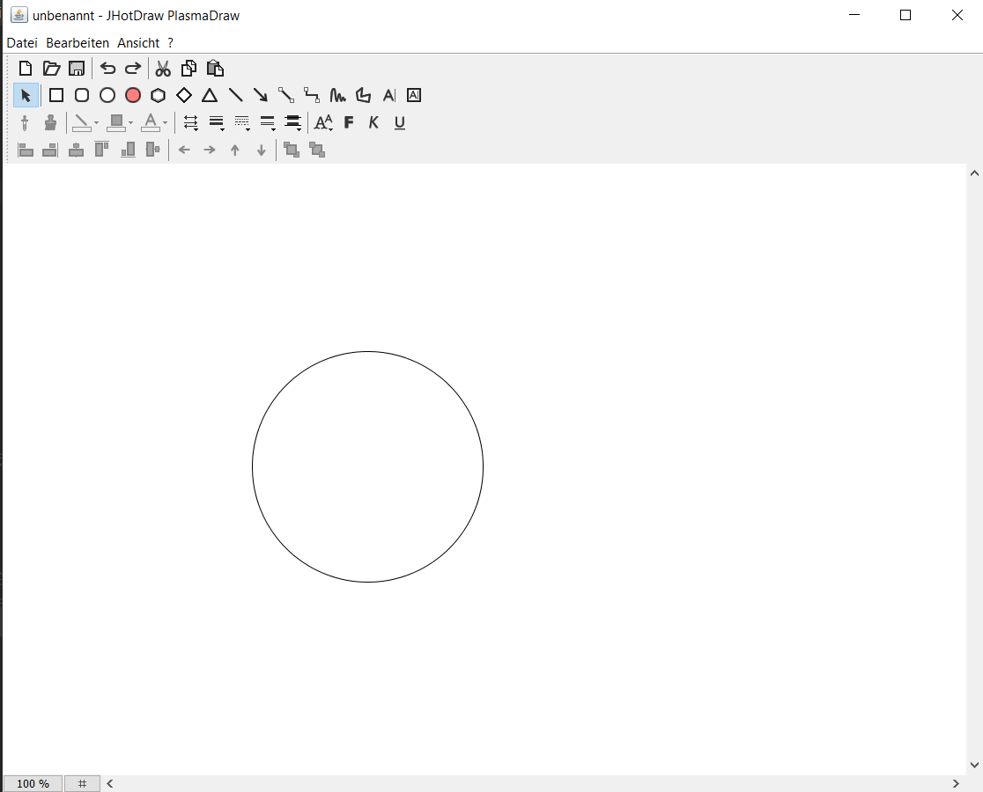
Task 1: Create Circle Function
Create a button which lets you draw circle
This function is similar to the createEllipse function
Feel free to reuse existing code!

Slide 6
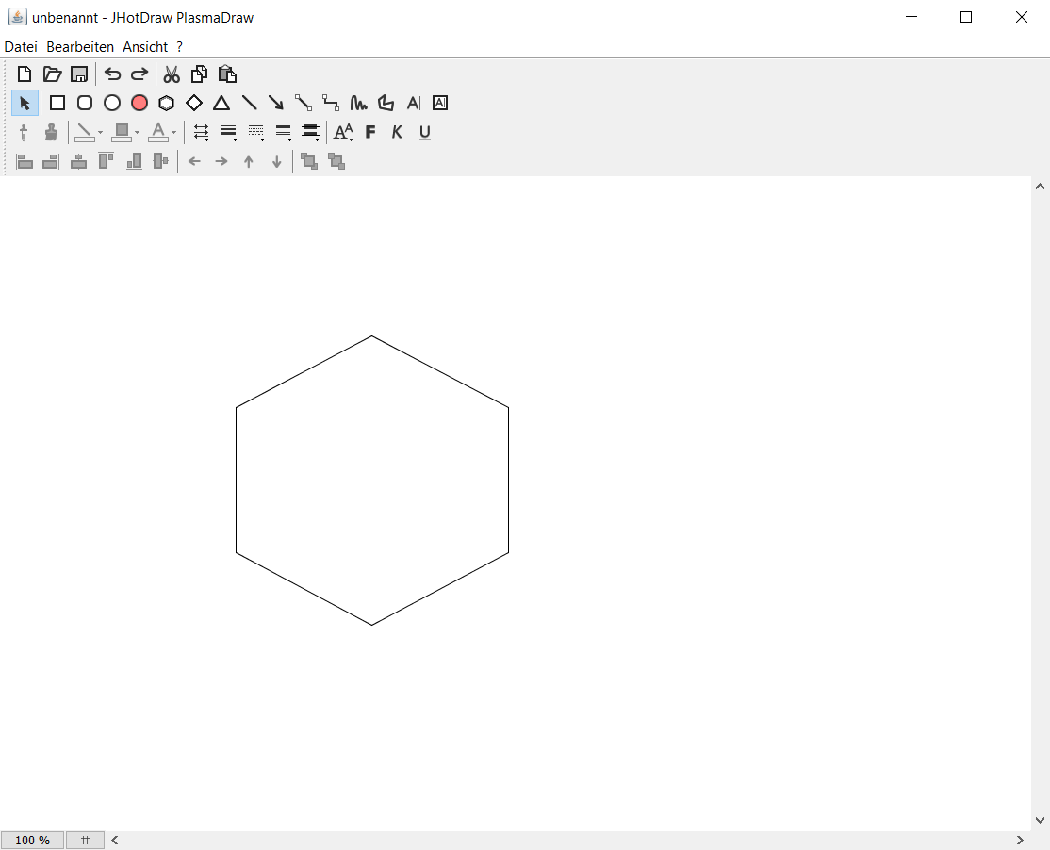
Task 2: Create Hexagon
Create a button which lets you draw hexagons
A graphic describing the geometry of a hexagon will help you in this task

Slide 7
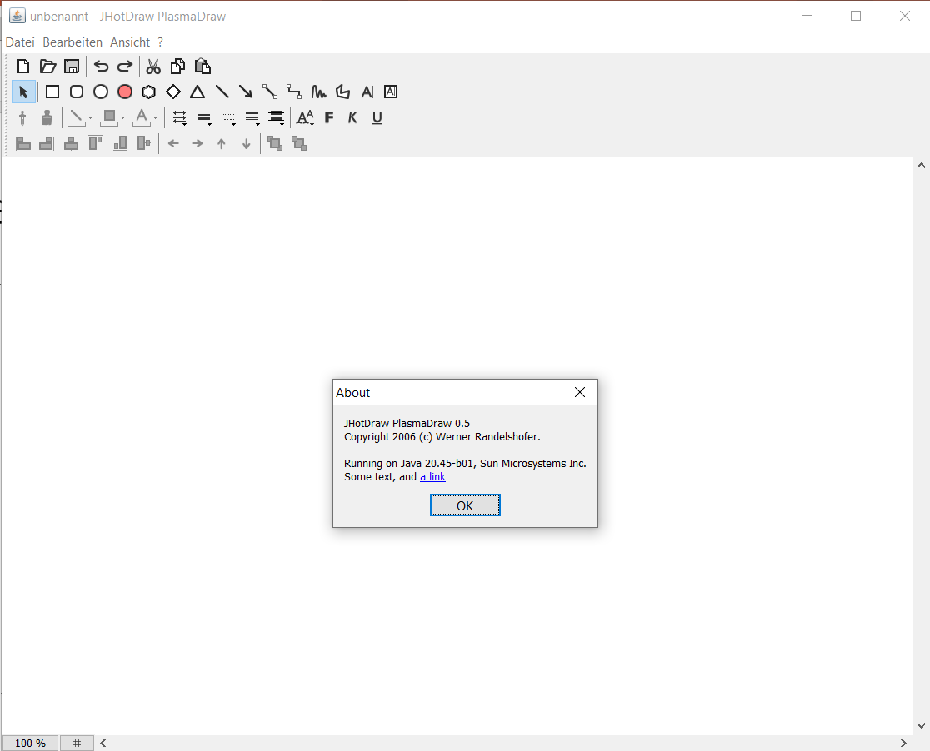

Task 3: Add Text with clickable Link
Add some text and a clickable link to the About window
You can navigate to the about window by clicking ?/Info

Slide 8
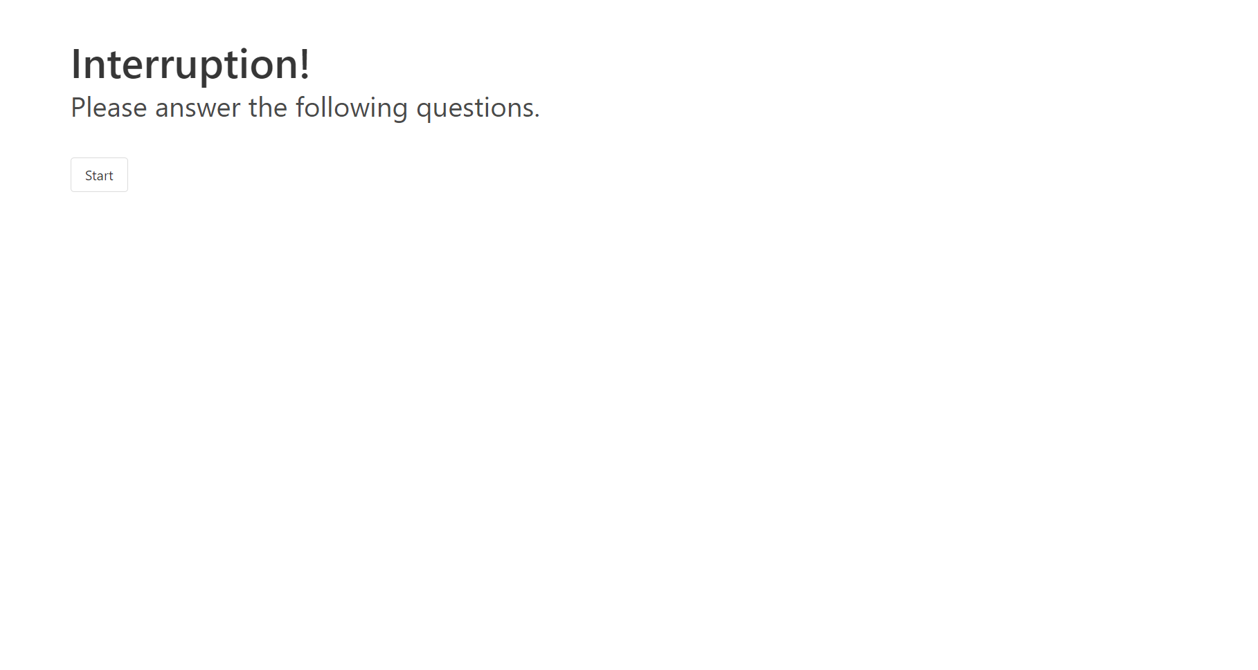
Interruptions I
Random Interruptions:
You will be interrupted every 1-11 minutes by the Tablet
The Tablet will switch from black to white
You will hear a notification sound
You do not need to address the interruption immediately
(Imagine responding to an interruption in real life by saying „just give me a moment“)
When ready, respond by pressing the Start button

Slide 9
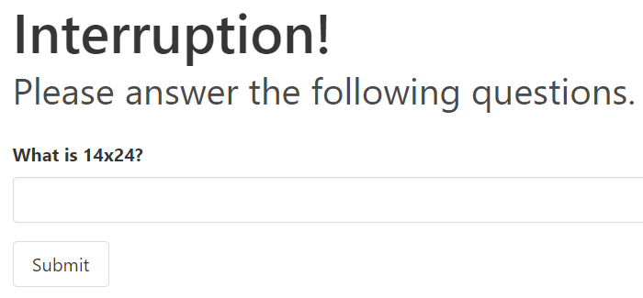
Interruptions II
Then solve a 2-digit multiplication
Mental Arithmetic:
Please try to solve the calculation in your head to your best effort
Please DO NOT use any helping tools (notes, calculator)
Hit submit

Slide 10
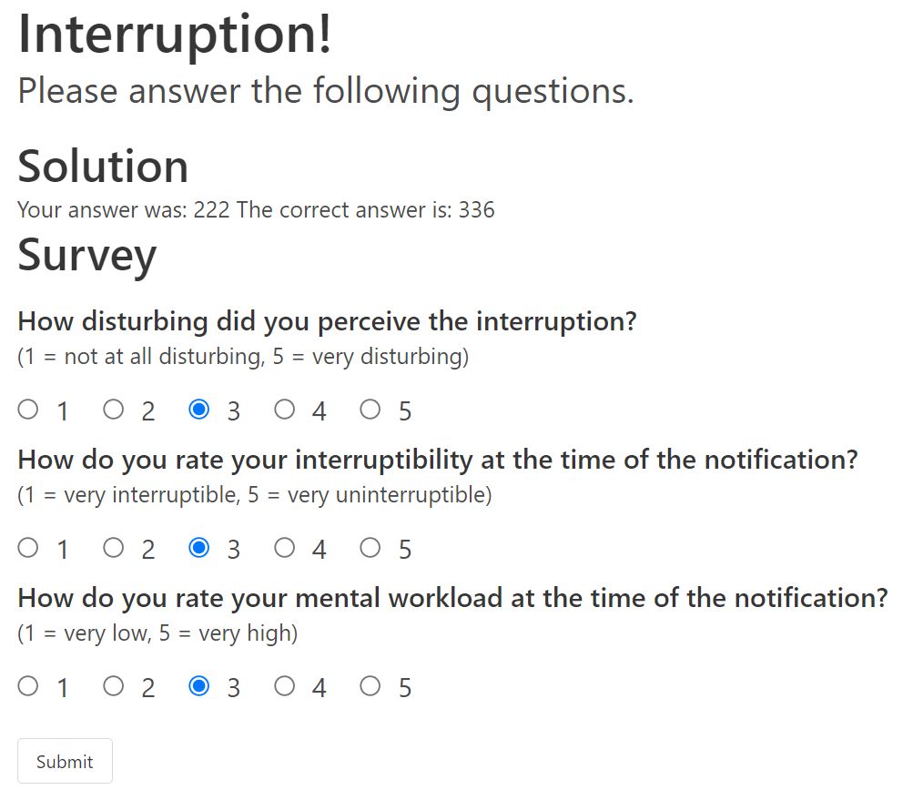
Interruptions III
Lastly fill out the survey
Hit submit
Afterwards the screen should turn black
Now you can continue working on the code tasks

